Slide 1

Assessment of Procurement Practices for Ophthalmic Items and Equipment Maintenance Management Systems
Meeting with Fred Hollows Foundation Team
19 July 2024
Dr. Leunora E. Okubasu & Team

Slide 2

Agenda
Our Core Team
01
Skills & Experience
02
Assignment Overview
03
Strategy & Timeline
04
Q & A
05
Notes:
https://unsplash.com/photos/CPs2X8JYmS8

Slide 3



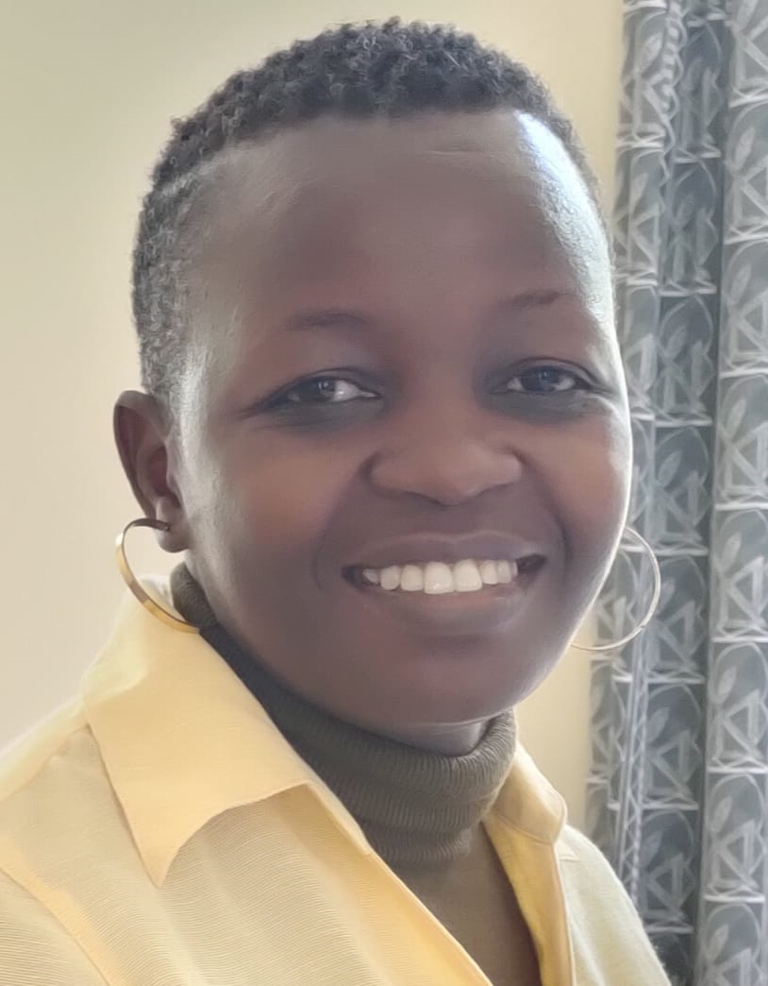
Our Core Team
Multi-disciplinary team with 50+ years of experience (collectively) implementing high impact interventions across the Health Systems Strengthening pillars.
Dr. Leunora Okubasu
Ms. Dorcas Odondo
Mr. Bengo Onyuka
Catherine Silali
Pharmacy / Procurement & Supply Chain Management
Project Lead
Procurement & Supply Chain Management
Operations Lead
Global Business & Sustainability / Information Technology
MEAL
Biomedical Engineering & Supply Chain Management
Equipment Operations and Maintenance Systems
Notes:
https://unsplash.com/photos/0Zx1bDv5BNY
https://unsplash.com/photos/315vPGsAFUk
https://unsplash.com/photos/DItYlc26zVI
https://unsplash.com/photos/FttBXHp7VZw
https://unsplash.com/photos/et_78QkMMQs

Slide 4

Skills & Experience
CORE COMPETENCIES
Strategic focus
Global Presence
Health Systems Assessments: Health Facility, Laboratory, Supply Chains, Procurement.
01
02
Continuous Quality Improvement (CQI)
Collaborative diagnosis of challenges (focused on HCD)
Co-creation of effective interventions
Client empowerment
Health Systems Strengthening
Monitoring and evaluation of interventions; development of suitable knowledge management systems
Africa: Kenya, Eritrea, Namibia, Nigeria, Somalia, Somaliland, Uganda, Zambia.
Kenya: 40+ Counties
Customized health workforce capacity building.
Innovative technology integration.
Delivered various multi-million dollar programs/projects funded by various development partners including PEPFAR, World Bank, BMGF, Save the Children, FCDO, KfW, JICA, GAVI, Plan International, among others
Worked with Ministries of Health in the region: TWGs, Task forces, etc
03
04

Slide 5

Assignment Overview
Our Understanding

Slide 6
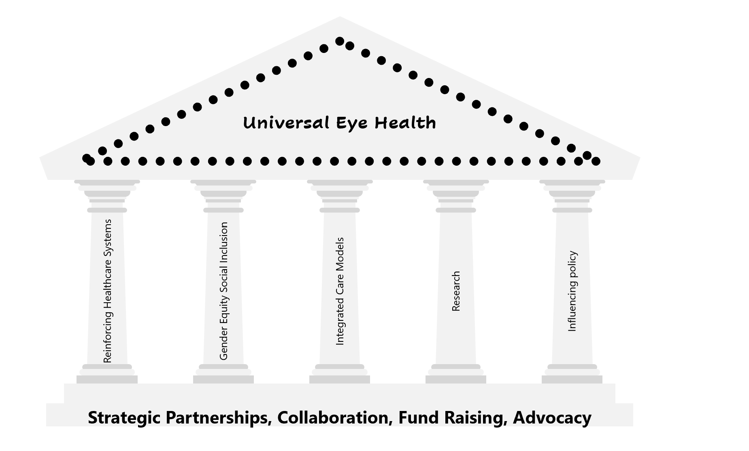
Preventable blindness Continuum of care & FHF Contribution
Screening
Diagnosis
Treatment
Post-treatment follow up
Demand creation
Laws, Policies, Regulations, guidelines
Appropriate referral systems
Stakeholder coordination, cooperation & collaboration
Among critical success factors for FHF are:
Stewardship of Resources +
Effectiveness of interventions

Slide 7
The challenges
Procurement
Inconsistent availability of HPT in local markets
Maintenance, Repair & Operations (MRO)
Lack of training – Operations of devices and equipment
Cross -cutting
Availability of eyecare instruments, equipment, supplies
Inadequate number of equipment
Protracted importation processes
Consideration of price (cheap) against quality
Procurement of non-standard equipment
Staff overwork
Poor sense of accountability
Lack of installation and MRO experts
Inappropriate referral systems
Lack of operational resources
Lack of standardized maintenance policies
No system of maintenance
Poor utilization of the above
HRH constraints (Volume + Capacity)
Poor quality equipment

Slide 8
Purpose of the Assignment
To analyze challenges in
Supply Chain Management
Procurement Processes
Maintenance of Ophthalmic related items
Notes:
Across board: Analyze existing systems, policies, guidelines and SOPs

Slide 9
Expected outcomes
Identify major gaps & challenges in
availing adequate and diverse ophthalmic items and equipment
Equipment management / maintenance, repair and operations
Propose doable and practical solutions to mitigate challenges
Generate evidence to advocate for system strengthening

Slide 10
The scope
Stakeholder Mapping (SM)
Identify stakeholders in the field
Identify their roles, power/influence
Supply Chain Mapping (SCM)
Map sample pharmaceuticals & medical supplies – Guided by FHF
Supply Chain Assessment (SCA)
Commodity Management Cycle: Selection, Quantification, Warehousing & Distribution, Use
Procurement Process Assessment (PPA)
Procurement policies: FHF, Partner Organizations, Host Governments
Equipment Maintenance Systems Assessment
Policies
Standard Operating Procedures
Maintenance Schedules
HRH (Volume + Capacity)
Assess functionality of any existing coordinating mechanism
Customize CMC to equipment
Track a sample of critical procurements – *Fidelity to policy
Review a sample of critical contracts
Notes:
Proposed recommendations
Propose Development of the Master List

Slide 11

Strategy and Timeline

Slide 12
Our Approach
Stakeholder Mapping and Engagement
Secondary Document Review
Field Visits, Data Collection & Analysis
Dissemination of Findings

Slide 13
Project Timeline
Kick off Meeting 1 Day
Communication brief/Inception Report
10 Days
Data Collection Readiness
10 Days
Desk Data Review
15 Days
Primary Data Collection
45 Days
Data Analysis/Report Writing
35 Days
Compile Recommendations / Develop Action Plan
(together with previous activity)
10 Days
Policy Advocacy
10 Days
Develop M&E Framework
10 Days
Capacity Building
4 Days

Slide 14

Proposed Budget
Two (2) Scenarios: No travel & Minimum Travel

Slide 15
No Travel

Slide 16
Minimal Travel

Slide 17

Q & A

Slide 18


